Slide 1
The Königssee
Bavaria, Germany

Slide 2
In the Berchtesgaden Alps near the Austrian border
Germany’s third deepest lake—623 feet
The mountains rise up to 8,900 feet beside it.
1,981 feet above sea level

Slide 3
Sea of Galilee or Lake Tiberias
After these things Jesus went over the sea of Galilee, which is the sea of Tiberias. (John 6:1)

Slide 4
Sunrise on the Sea of Galilee

Slide 5
And it came to pass, that, as the people pressed upon him to hear the word of God, he stood by the lake of Gennesaret, (Luke 5:1)
In the time of Christ the Sea of Galilee (or Lake of Gennesaret) bordered on the richest and most populous district of Palestine.

Slide 7
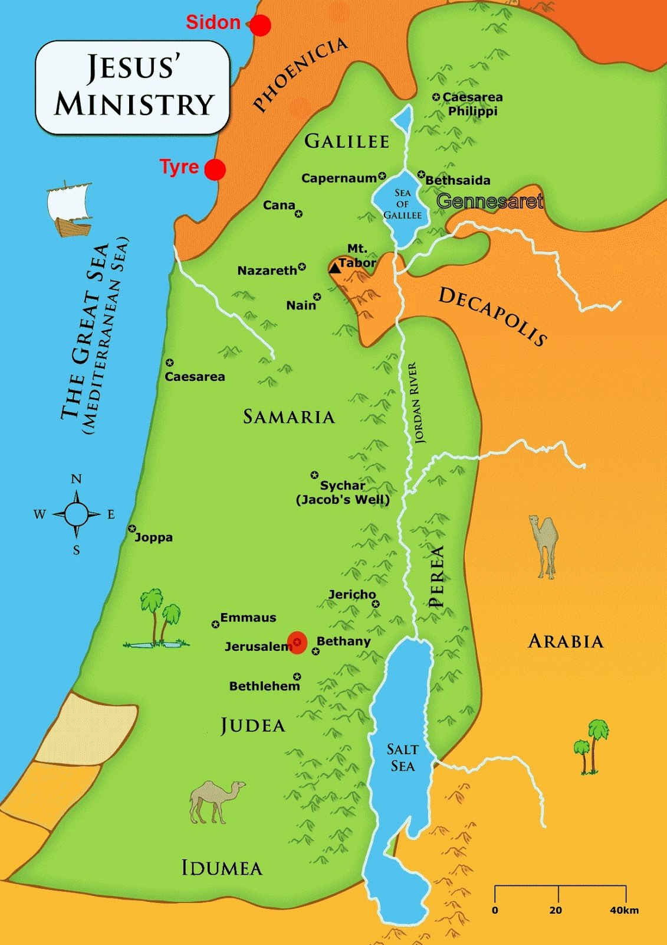
(Now Hiram the king of Tyre had furnished Solomon with cedar trees and fir trees, and with gold, according to all his desire,) that then king Solomon gave Hiram twenty cities in the land of Galilee. (1 Kings 9:11)

Slide 8
Sea of Galilee
The lowest fresh water lake on Earth
The second lowest lake on Earth (after the Dead Sea, a salt water lake), about 700 feet below sea level
Partially fed by underground springs but mostly fed by the Jordan River
About 141 feet deep

Slide 9
The water level is daily monitored for dangerously low levels.
The Sea of Galilee is at risk of becoming irreversibly salinized by the salt water springs under the lake, which are held in check by the weight of the freshwater on top of them.
With extreme drought conditions continuing to intensify, the government of Israel approved a plan in 2018 to pump desalinated water into the lake in an effort to stop the water level from plunging below a point where irreversible ecological damage to the lake might take place.

Slide 10
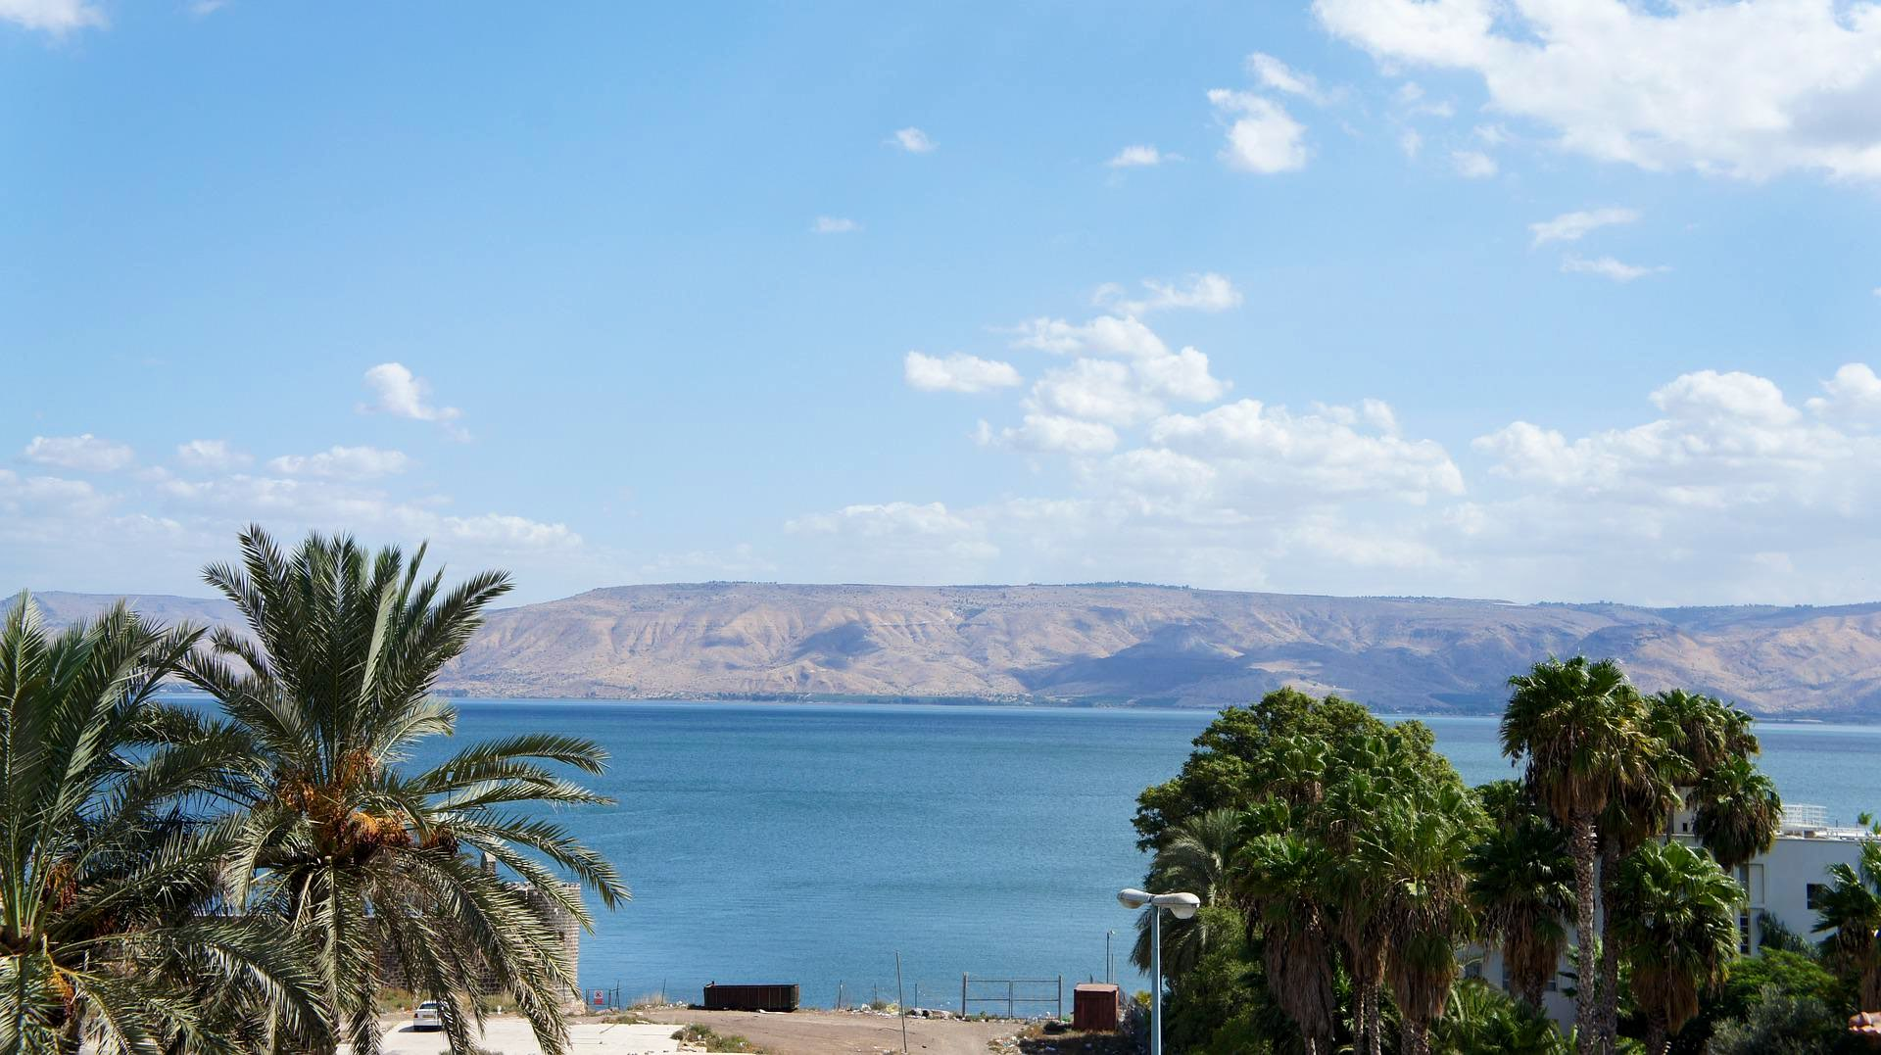

Slide 11
The lake supplies approximately 10% of Israel’s drinking water needs.
In 1964 Syria attempted construction of a Headwater Diversion Plan that would have blocked the flow of water into the Sea of Galilee, sharply reducing the water flow into the lake. This project and Israel’s attempt to block these efforts in 1965 were factors which played into regional tensions culminating in the 1967 Six-Day War. During the war, Israel captured the Golan Heights, which contain some of the sources of water for the Sea of Galilee.

Slide 12
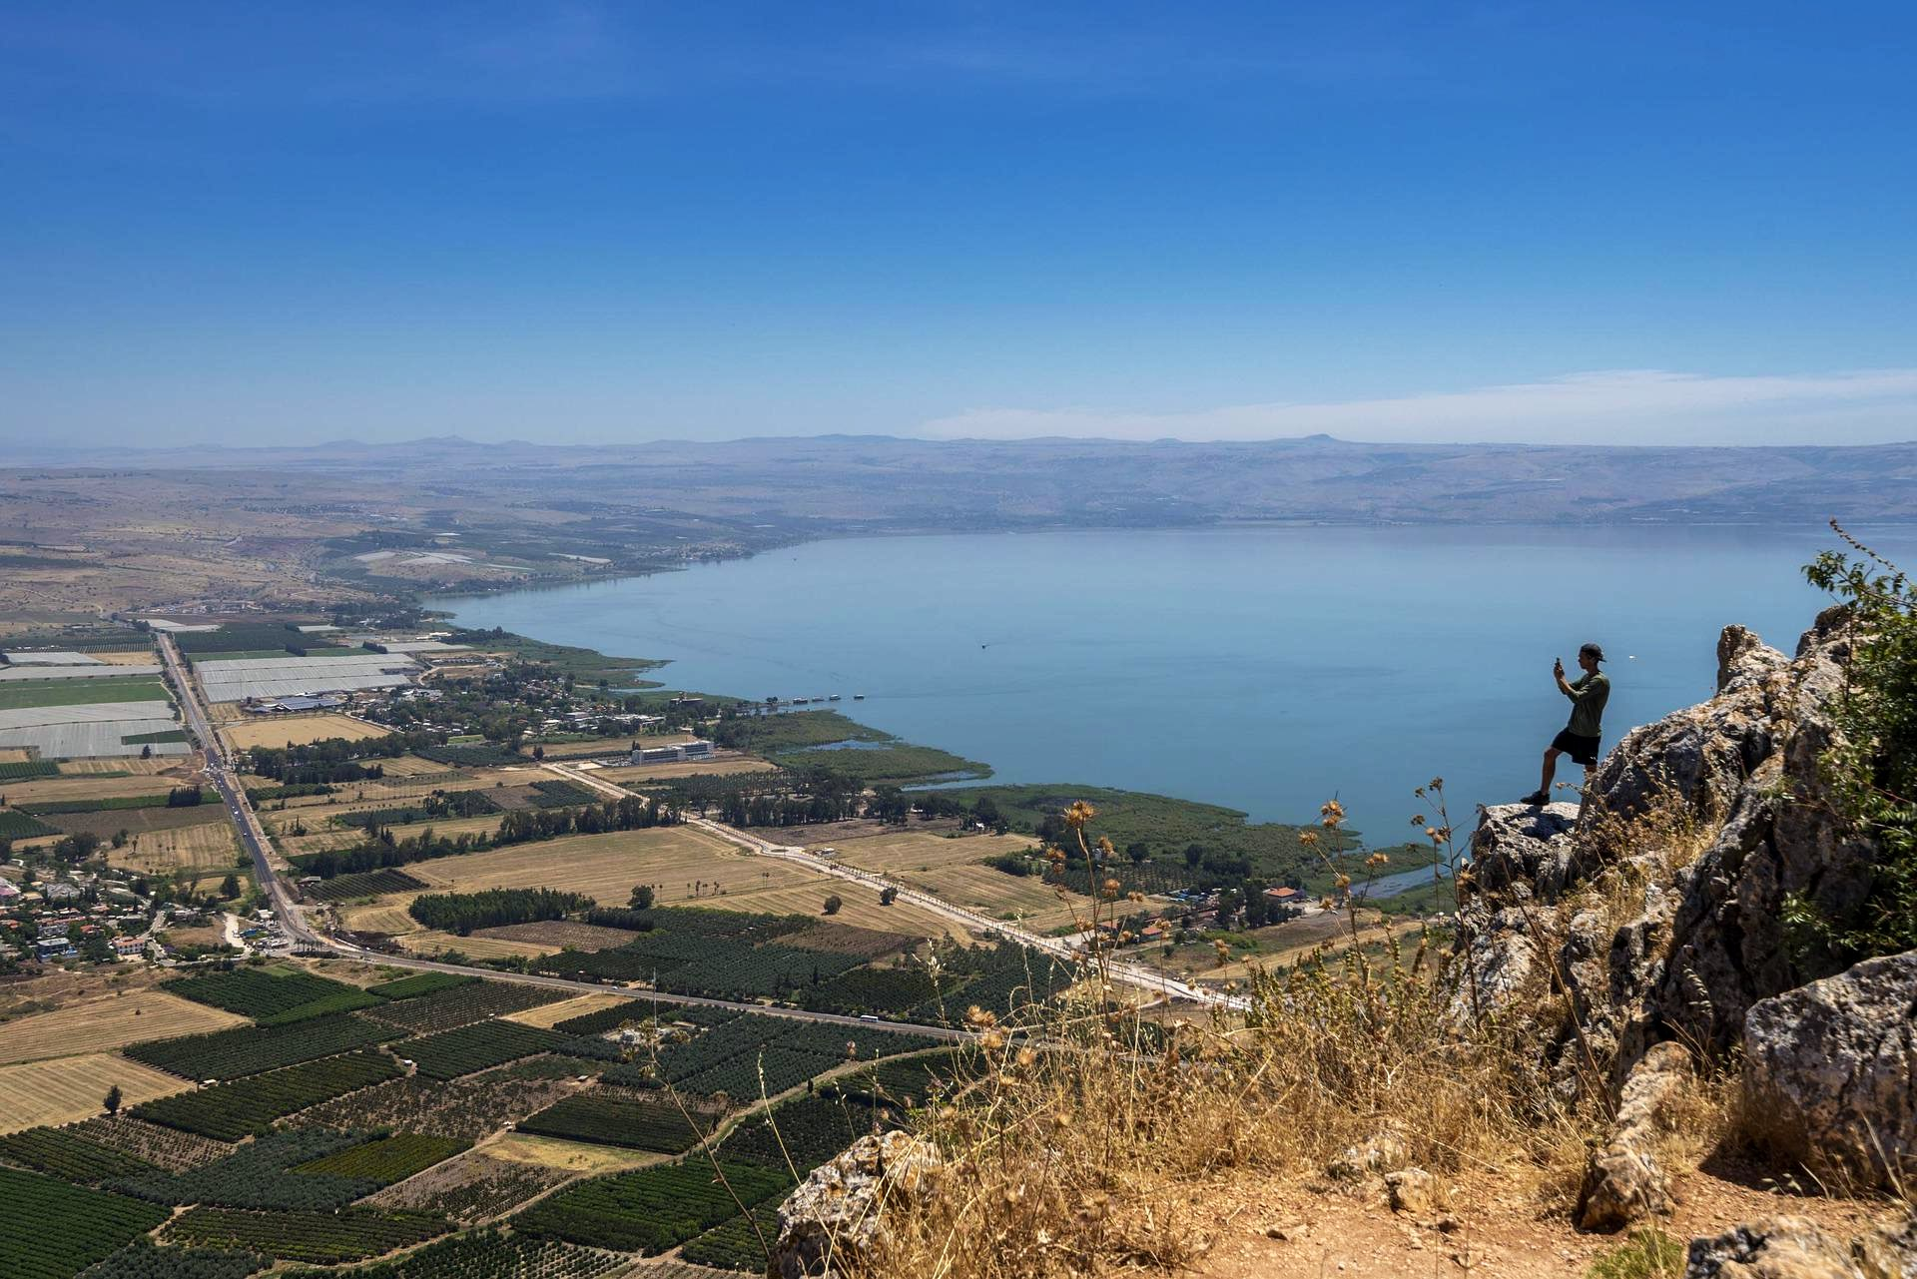

Slide 13
Jordan is considered one of the ten most water scarce countries in the world.

Slide 14
